Slide 1

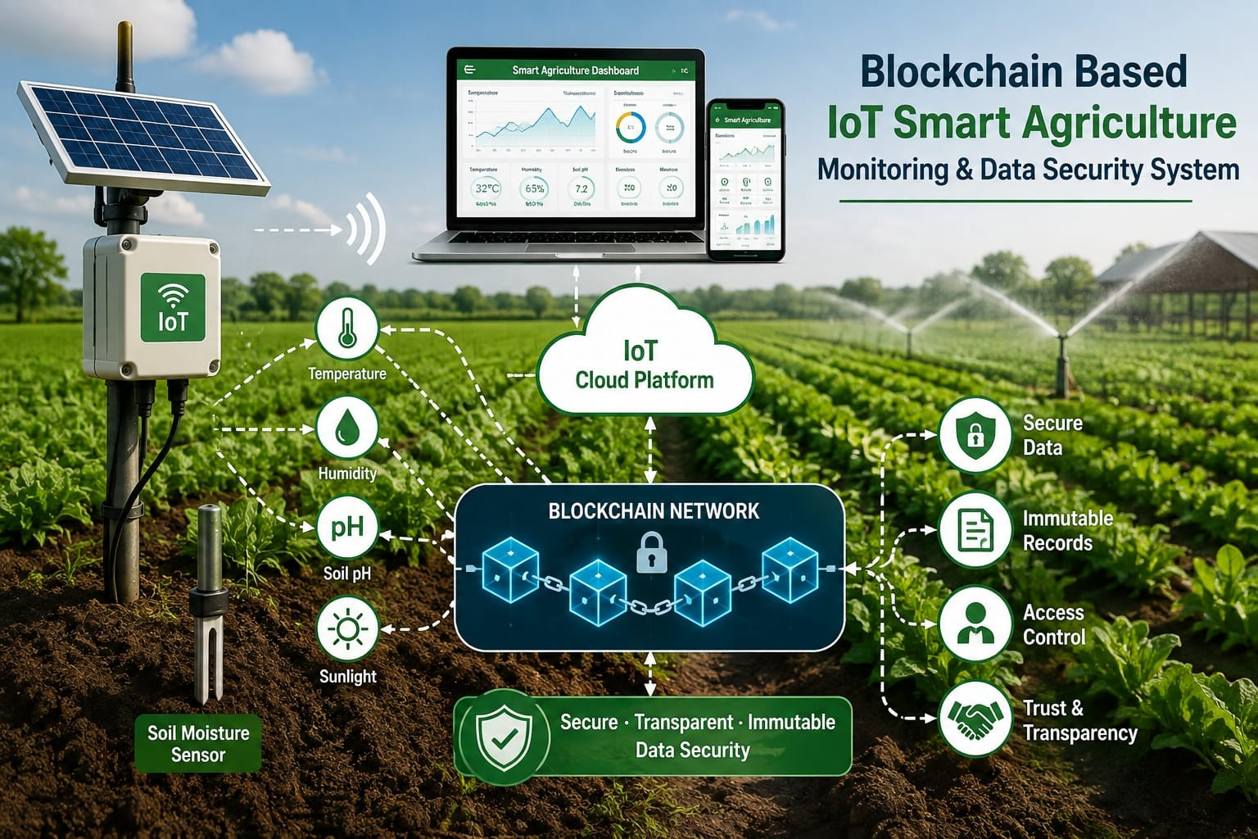
DEPARTMENT OF CSE(IOT AND CYBER SECURITY INCLUDING BLOCKCHAIN TECHNOLOGY)
Blockchain-Based IoT Smart Agriculture Monitoring and Data Security System
GROUP MEMBERS:
AISHWARYA PRABHA(3GN23IC005)
AKSHATA(3GN23IC007)
SHARANAMBE(3GN23IC047)
PRIYANKA(3GN23IC036)

Slide 2
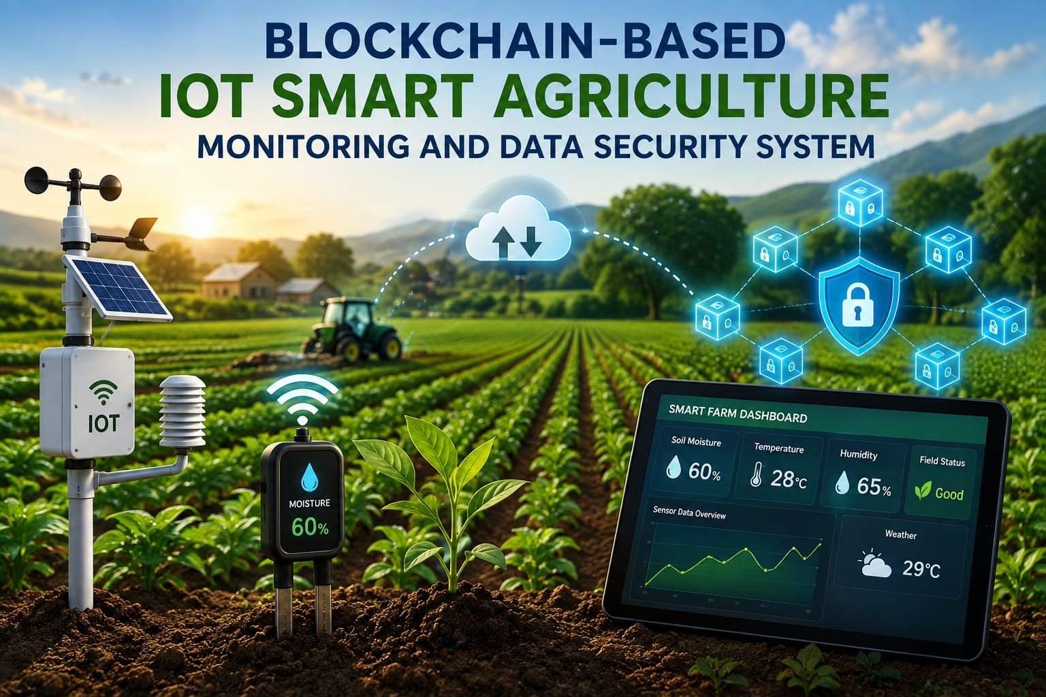
1. Project Title and Problem Statement
Project Title: Blockchain-Based IoT Smart Agriculture Monitoring and Data Security System
• Traditional agriculture monitoring requires continuous observation of environmental and soil conditions.
• Agricultural sensor data may be difficult to manage securely and can be vulnerable to unauthorized modification.
• A secure, transparent and technology-based monitoring system can help improve data management.
2

Slide 3
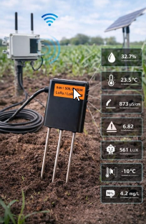
2. Objectives
• Monitor agricultural parameters using IoT sensors.
• Collect data such as soil moisture, temperature and humidity.
• Enable real-time monitoring of farm conditions.
• Improve the security and integrity of important agricultural data using blockchain.
• Provide a foundation for secure and smart agriculture management.
3

Slide 4
3. Proposed System Architecture / Block Diagram
IoT Sensors
ESP32 / Controller
Data Processing
Blockchain Security
Dashboard / User
Proposed flow: Sensors collect data → Controller transmits data → Data is processed → Important records are secured → User monitors information.
4

Slide 5
4. Proposed Hardware Components
ESP32 / Arduino
Main microcontroller
Soil Moisture Sensor
Measures soil moisture
Temperature Sensor
Measures temperature
Humidity Sensor
Measures humidity
Wi-Fi Connectivity
Transfers data to the system
Power Supply
Provides power to components
5

Slide 6
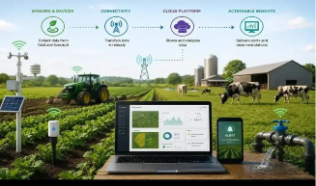
5. Proposed Software Components
• Arduino IDE – Programming and interfacing with the microcontroller.
• Python – Data processing and backend development.
• Blockchain Platform / Framework – Securing important agricultural records.
• Cloud Database – Storing and managing sensor information.
• Web or Mobile Dashboard – Displaying monitored agricultural data.
6

Slide 7
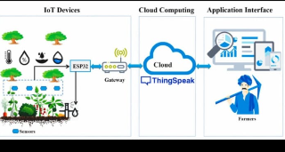
6. Hardware–Software Integration
1
Sensors collect agricultural data
2
ESP32 receives sensor readings
3
Data is transmitted using Wi-Fi
4
Software processes and stores the data
5
Blockchain secures important records
6
Dashboard displays information to the user
7

Slide 8
8. Working Prototype / Demo
Prototype Status: Under Development
• The working prototype has not yet been implemented.
• The current review focuses on the proposed architecture and implementation plan.
• The next phase will involve hardware setup, data collection, blockchain integration and testing.
9

Slide 9
10. Future Scope
• Connect and test IoT sensors with the microcontroller.
• Develop the sensor data collection and transmission system.
• Implement blockchain-based data security.
• Create a web or mobile monitoring dashboard.
• Build and test the complete working prototype.
• Future enhancement: automatic irrigation, AI-based crop recommendations and weather integration.
11

Slide 10
THANKS

